Slide 1

A Project Review Meeting on Flash Deals And Sales Engine
By
Name : A. Charan Teja roll: 2520030418
Name : D . Venkata Mahith roll: 2520030497
Team Number: 1
Under the guidance of
D. Pavithra
Assistant Professor
Department of Computer Science and Engineering
Koneru Lakshmaiah Education Foundation (Deemed to be University estd. u/s. 3 of the UGC Act, 1956) Off-Campus: Bachupally-Gandimaisamma Road, Bowrampet, Hyderabad, Telangana - 500 043. Phone No: 7815926816, www.klh.edu.in

Slide 2
Outline of the Presentation
Abstract
Introduction
Problem Statement
Project Flow Diagram
Objectives with Justification
Modules[Frontend web pages]
Expected Outcomes of the Proposed Work
Conclusion
References

Slide 3
Abstract
The Flash Sales and Deals Engine is a web-based platform developed to simplify the management of promotional campaigns, flash sales, and special discount offers in e-commerce applications. The system enables administrators to create, schedule, and monitor limited-time deals while providing customers with an easy way to discover and purchase discounted products. By automating promotional activities and offering real-time updates, the platform improves customer engagement, increases sales, and enhances the overall shopping experience.

Slide 4
Introduction
In today's competitive e-commerce environment, and the businesses rely heavily on promotional campaigns and flash sales to attract customers and boost revenue. However, managing these campaigns manually can be complex and inefficient, especially when dealing with large product inventories and multiple offers simultaneously. The Flash Sales and Deals Engine provides an automated solution that streamlines deal management, improves operational efficiency, and ensures that customers receive timely and relevant promotional offers. The system helps businesses maximize the effectiveness of their marketing strategies while delivering a seamless shopping experience to users.

Slide 5
Problem Statement
Many e-commerce businesses face challenges in the effectively managing promotional campaigns and delivering personalized offers to customers. Traditional systems often lack automation, resulting in difficulties such as delayed updates, inaccurate inventory management, and poor customer engagement. Furthermore, customers may miss attractive deals due to the absence of a centralized platform for managing and displaying offers. Therefore, there is a need for an efficient system that automates deal creation, scheduling, monitoring, and reporting while ensuring a smooth and engaging user experience.

Slide 6
Project Flow Diagram
Admin
↓
Deal Creation
↓
Deal Validation
↓
Deal Publishing
↓
Customer Browsing
↓
Cart & Checkout
↓
Order Processing
↓
Inventory Update
↓
Sales Analytics
↓
Report Generation

Slide 7
Objectives with Justification
The primary objective of the project is to automate the process of creating and managing flash sales, thereby reducing manual effort and minimizing errors. Another objective is to improve customer engagement by providing attractive and personalized deals. The system also aims to offer real-time updates on product availability and pricing, ensuring transparency and reliability. Additionally, it seeks to increase sales and revenue through effective promotional strategies while generating analytical reports that support data-driven decision-making. These objectives contribute to improving business efficiency and customer satisfaction.

Slide 8
Modules [Frontend web pages]
CO1:
Home Page → Component-driven UI, declarative rendering, Virtual DOM
Deals Dashboard → Unidirectional data flow, state lifting, API integration
Flash Sale Page → Countdown Timer component, reconciliation, re-rendering
CO2:
User Registration & Login → ES6+ patterns, use State , controlled forms, async/await
Product Listing Page → Async fetch, skeleton UI, container-presenter pattern
Inventory Management → Server API (index.js), async data, stale state handling
CO3:
User Registration & Login → ES6+ patterns, use State , controlled forms, async/await
Flash Sale Page → Countdown Timer component, reconciliation, re-rendering
Shopping Cart → Cart Sidebar state mgmt. , qty update, lifted state (App.js)
Checkout & Payment → Checkout Modal, multi-step form, validation, OTP verify
CO4:
Deals Dashboard → Unidirectional data flow, state lifting, API integration
Product Listing Page → Async fetch, skeleton UI, container-presenter pattern
Order Management → Orders Page, SPA routing (/orders), protected routes
Admin Deal Management → React Context (Auth Context), global state, derived state
Inventory Management → Server API (index.js), async data, stale state handling
CO5:
Checkout & Payment → Checkout Modal, multi-step form, validation, OTP verify
Order Management → Orders Page, SPA routing (/orders), protected routes
Analytics Dashboard → Performance tuning, memorization , Lighthouse-ready build
Notifications Module → Wishlist Sidebar, ARIA accessibility, Vite bundling/deploy
CO6:
Analytics Dashboard → Performance tuning, memorization , Lighthouse-ready build
Notifications Module → Wishlist Sidebar , ARIA accessibility, Vite bundling/deploy

Slide 9
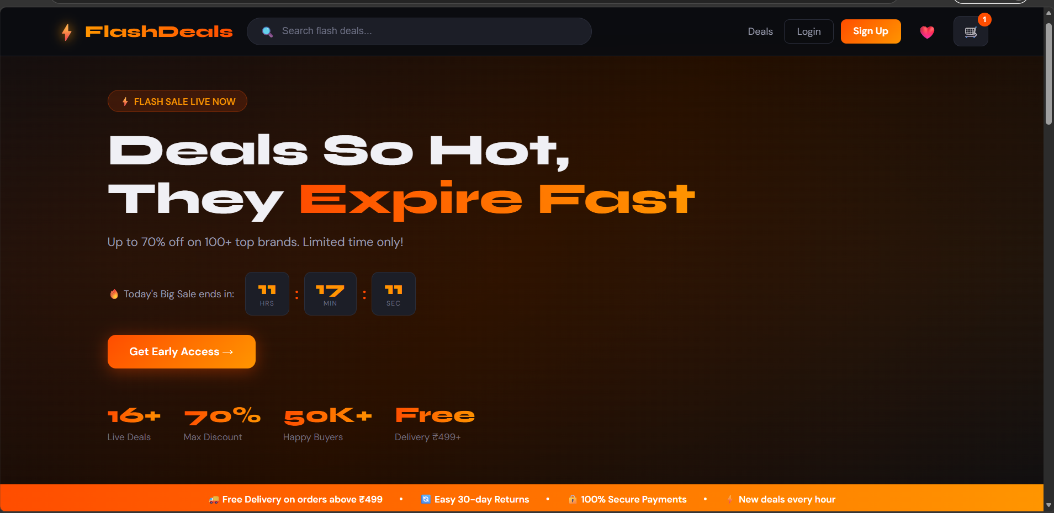
Expected Outcomes of the Proposed Work

Slide 10
Conclusion and Future Scope
The Flash Sales and Deals Engine offers an effective solution for managing promotional campaigns and limited-time offers in e-commerce environments. By automating deal creation, scheduling, monitoring, and reporting, the system enhances operational efficiency and improves customer satisfaction. It serves as a valuable tool for businesses seeking to increase sales and strengthen customer relationships through targeted promotions. In the future, the system can be enhanced by integrating artificial intelligence for personalized deal recommendations, developing mobile applications for wider accessibility, implementing dynamic pricing mechanisms, and supporting multi-vendor marketplaces. Advanced analytics and customer behavior prediction can further improve the effectiveness of promotional campaigns.

Slide 11
References
The development of this project is based on concepts and technologies from various sources, including research papers on e-commerce promotion management systems, official documentation of React.js, Node.js, and MySQL, software engineering textbooks, and digital marketing analytics resources. These references provide the theoretical and technical foundation required for designing and implementing the Flash Sales and Deals Engine.

Slide 12
Thank you

